Slide 1

What is a Content Management System ?

Slide 2

What is a Content Management System ?
A Content Management system ……..
……… is simply a system that manages digital content !
Too simple ?
Notes:
Short and Sweet – Summary of current position within the CMS marketplace and an independent assessment of our rating by Gartner

Slide 3

Defining a Content Management System
In order to define a content management system, we need to look at the components the term is made up of……..
What is ‘Content’ ?
What does the ‘Management’ of content refer to ?
What is the ‘System’ that manages the content ?
Notes:
Short and Sweet – Summary of current position within the CMS marketplace and an independent assessment of our rating by Gartner

Slide 4









What is ‘Content’ ?
Content is in essence, any type or 'unit' of digital information.
It can be text, images, graphics, video, sound, documents, records etc
……or in other words, it can be anything that is likely to be stored and managed in an electronic format.
Notes:
Short and Sweet – Summary of current position within the CMS marketplace and an independent assessment of our rating by Gartner

Slide 5

What does the ‘Management’ of content refer to ?
Because the information being managed is digital in nature – the method of managing is also typically conducted electronically.
The ‘Management’ refers to the process of storing content via rules and process (or a combination of the same) - often with associated workflows - so that the content is deemed to be ‘managed’ rather than ‘unmanaged’ where it is located.
Notes:
Short and Sweet – Summary of current position within the CMS marketplace and an independent assessment of our rating by Gartner

Slide 6

What is the ‘System’ that manages the content ?
The ‘System’ itself is definable as a software tool, or combination or software tools, that facilitate the efficient and effective management of the content so as to achieve the desired 'output‘ (which can be electronic or hardcopy).……..
…..so pulling all three definitions together……..
Notes:
Short and Sweet – Summary of current position within the CMS marketplace and an independent assessment of our rating by Gartner

Slide 7

What is a ‘Content Management System’ ?
Combining all three definitions we get the following;
A CMS is a software tool that enables groups of (centralised) technical and (de-centralised) non technical staff to store, create, edit, manage and publish a variety of digital content types to an intended audience, whilst being constrained during the content process by a centralised set of rules, process and workflows that ensure coherent, validated and managed electronic content is produced.
Notes:
Short and Sweet – Summary of current position within the CMS marketplace and an independent assessment of our rating by Gartner

Slide 8
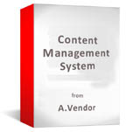
So how come there are so many CMS solutions ?
Given that there are many different types of digital content.…..it follows that there are many different types of CMS (some crossing over from one type to another) – these are the most common examples;
Web Content Management
Document Management
Records Management
Collaboration including Web 2.0 (Forums, Blogs)
Digital Asset Management
Portal Content Management
Enterprise Content Management (all off the above)

Slide 9
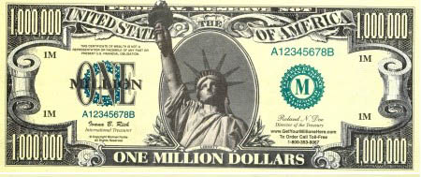
Which CMS is right for me ?
Have you got one of these to pay for your question ?
The type of CMS that meets your requirements will depend on the type or types of content you wish to manage, the size of your organisation, in-house resources, size and type of content experience you are managing……and many other factors……..
Notes:
Short and Sweet – Summary of current position within the CMS marketplace and an independent assessment of our rating by Gartner

Slide 10
Which CMS is right for me ?
You could of course contact us at www.contentmanager.eu.com……..
After you have explained your requirements, we will provide you with an assessment of which type of CMS solution meets your needs
It could be one product, it could be multiple CMS products – or it could be a recommendation to try a different solution altogether based on your given information.
By email steve@contentmanager.eu.com
Notes:
Short and Sweet – Summary of current position within the CMS marketplace and an independent assessment of our rating by Gartner

